Slide 1
LTE and 5G: How the $4letterword Does it Work?
A brief introductory discourse by nobletrout about how he used a lot of google and a little direction at his last job to figure out some complicated stuff

Slide 2
What are we going to talk about tonight?
A minor history guide
A guide to LTE/5G components using more familiar elements as analogues
“Where to hack” not “how to hack”
A lot of gordian knot cutting
Most of us here understand a lot of complicated stuff. This is just applying that knowledge to a new set complicated stuff clouded in new jargon.
Some slides are old, some are new
Big picture stuff here guys, the weeds are for tomorrow
Notes:
Tonight will be a talk that rambles between a complaining about people, pointless barriers, reading lots of documentation, and finding those little nuggets of information that point out large problems with things. I will guide you through understanding a large part of the complexities of mobile networks, how they work, how they are setup, and why there are lots and lots of skeletons most likely hidden in those walls.
I’m not going to spend much time on “how to hack” LTE or 5G, since after I point where the attack surfaces are, you’ll have plenty of time to find your own stuff out there to hack to and irritate.

Slide 3

When in doubt, blame the French
This Photo by Unknown Author is licensed under CC BY-SA
Notes:
A guiding light throughout this presentation will be the following sage advce: If you are lost, confused, and wondering what the hell all this is about, blame the French.
3GPP – 3rd Generation Partnership Project
Founded by ETSI (European Telecommunications Standards Institute )
All of this is code for “French people and some other Europeans”
If you start hearing me use a bunch of acronyms, just make the words into things themselves and don’t worry about the acronyms because NO ONE knows what they are.
For instance, you’ll hear about GTP
GTP is GPRS Tunneling Protocol
GPRS means
General Packet Radio Service
So GTP is really General packet Radio Service Tunneling Protocol, or GPRSTP. This is just one, common, well known example. Don’t try to keep up it isn’t worth it.
https://www.qualcomm.com/news/onq/2017/08/02/understanding-3gpp-starting-basics

Slide 4

Free!

Slide 5
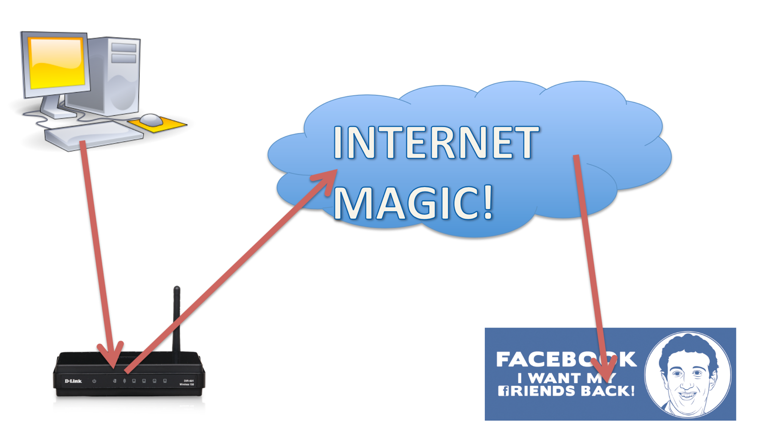
How normals view how the Internet works
Notes:
So here we have a common diagram of how most people think the internet works. You know, I know, most of us here know, there’s more going on in there than just this

Slide 6
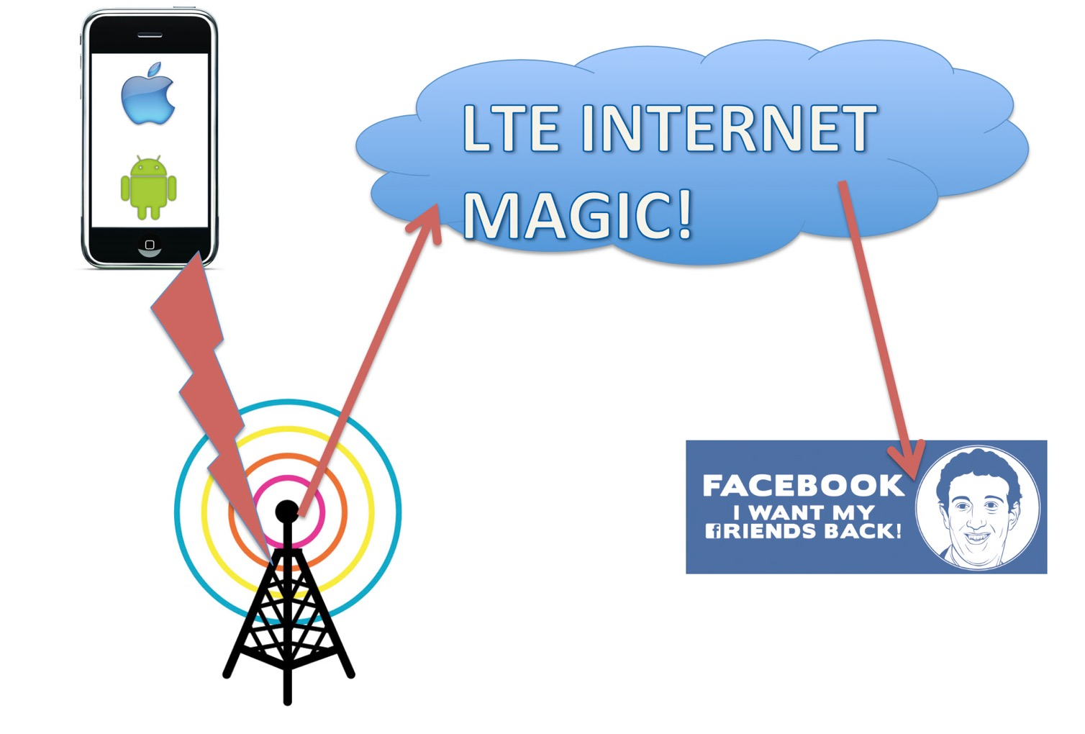
How most people think LTE/5G works
Notes:
But if I replace the WiFi router/cable modem with a cellphone tower, how comfortable do you become with understanding how your internet connection works? Are you sure you know how your phone actually works, what it does? How confident are you about the communication protocols and connection setup works?

Slide 7
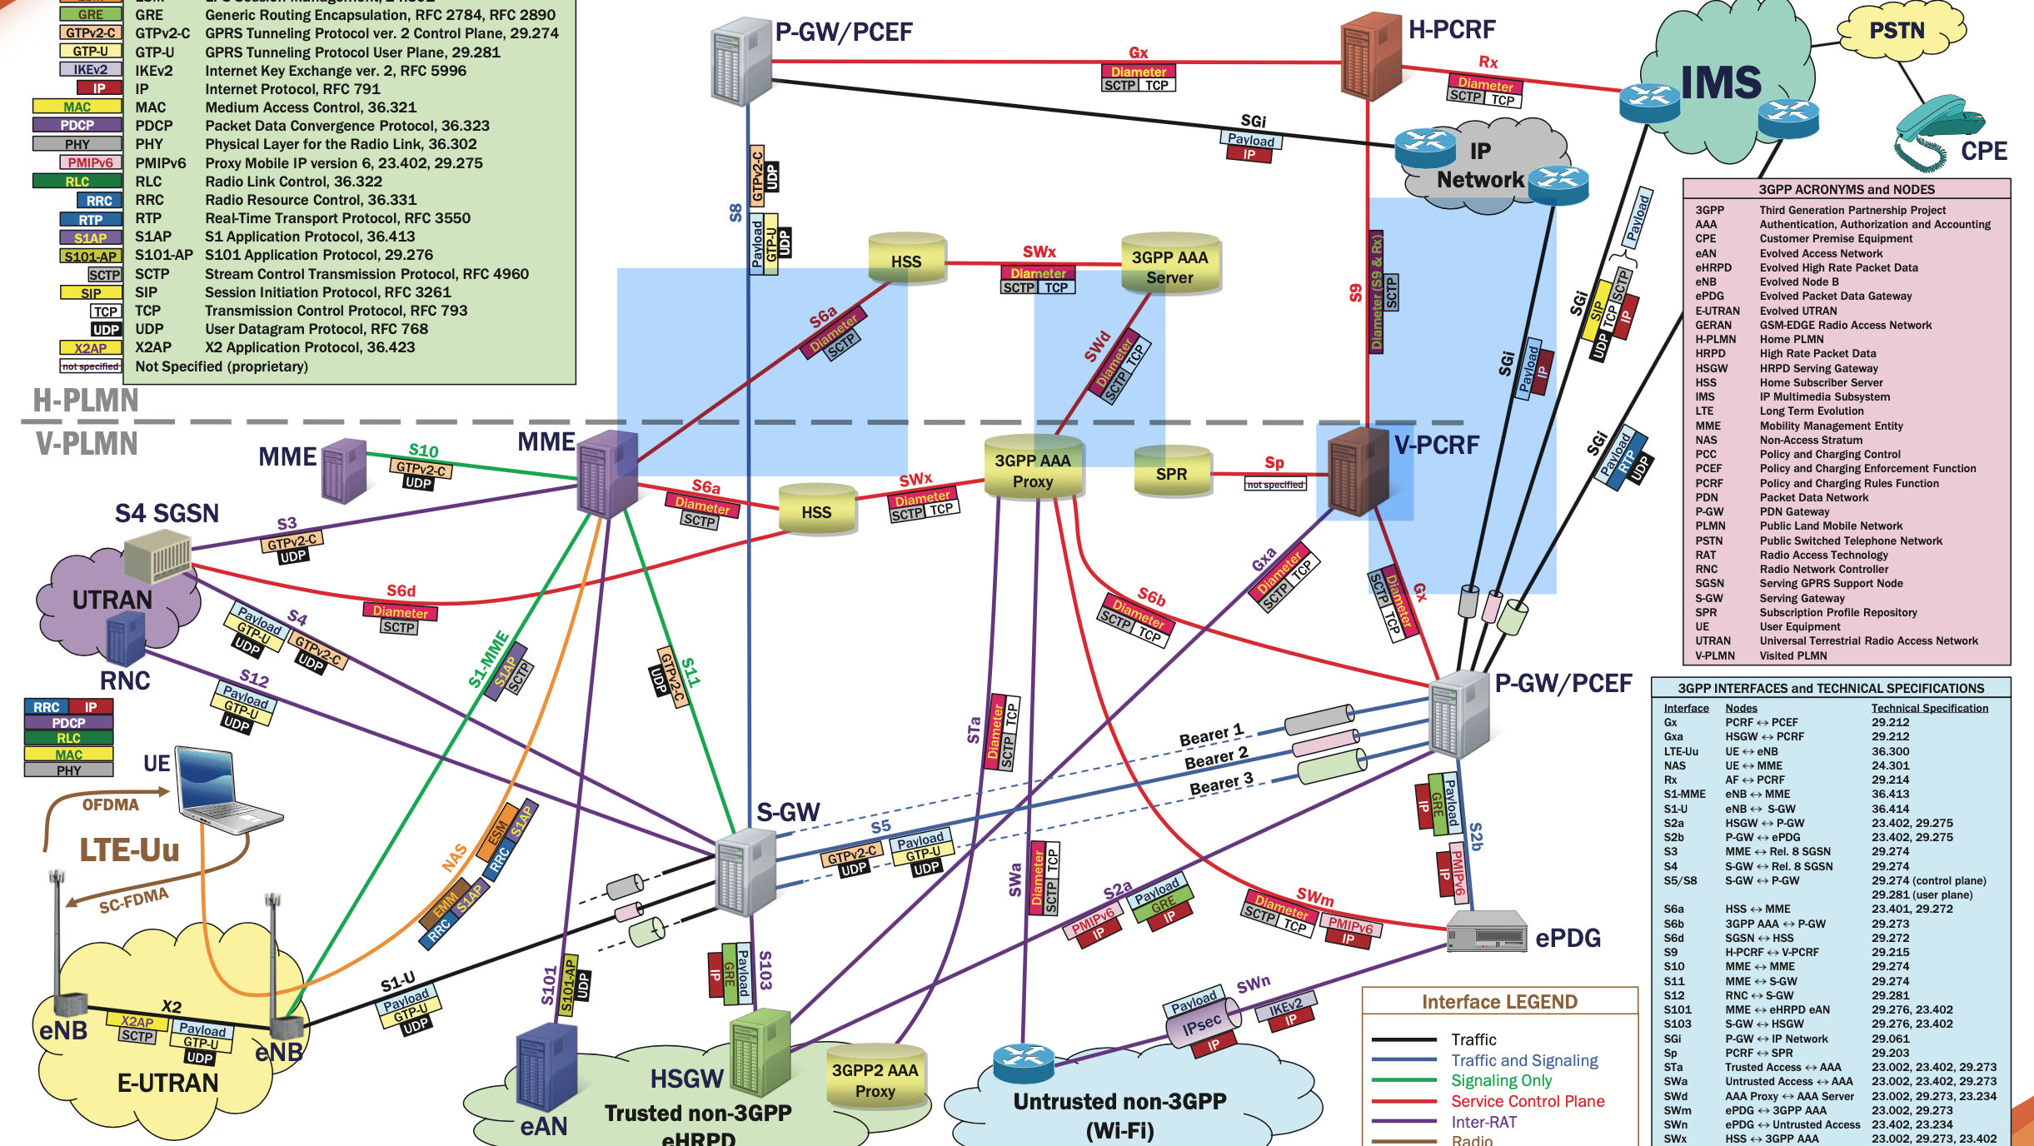
It gets worse
Notes:
COMPLICATED
LTE here, or even 5G, can look ridiculously scary, especially when you start throwing in all the legacy items that are required for backwards compatibility. In here you can see roaming, 2g and 3g support, even femto cell support and concepts.

Slide 8
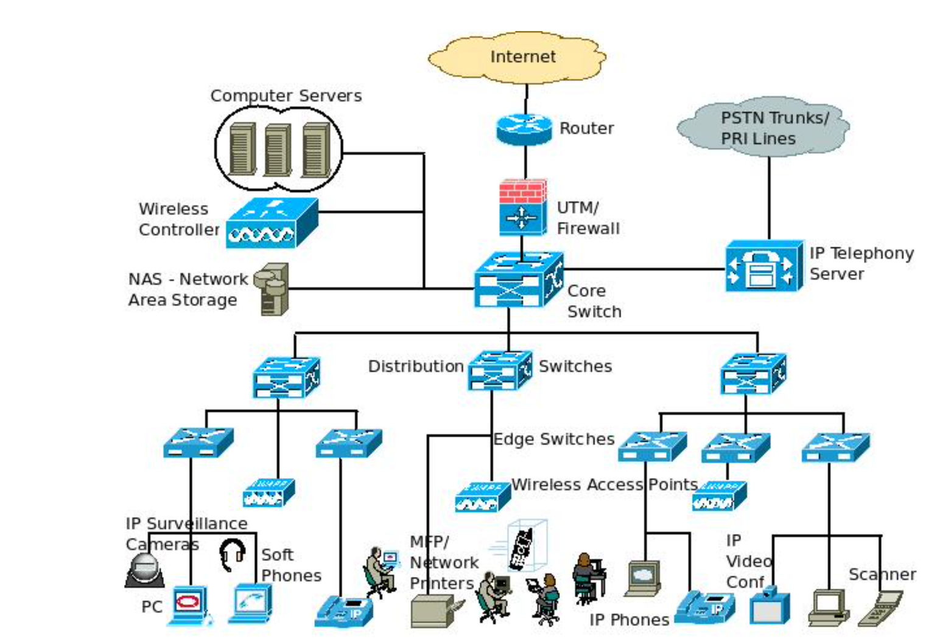
However
Notes:
But if I showed you a big scary diagram of say, a legacy network for an enterprise, nothing here would really scare you. So what is the big difference? I would say it’s mostly just acronyms and a lack of understanding of a few basic elements. So let’s demystify this stuff here.

Slide 9
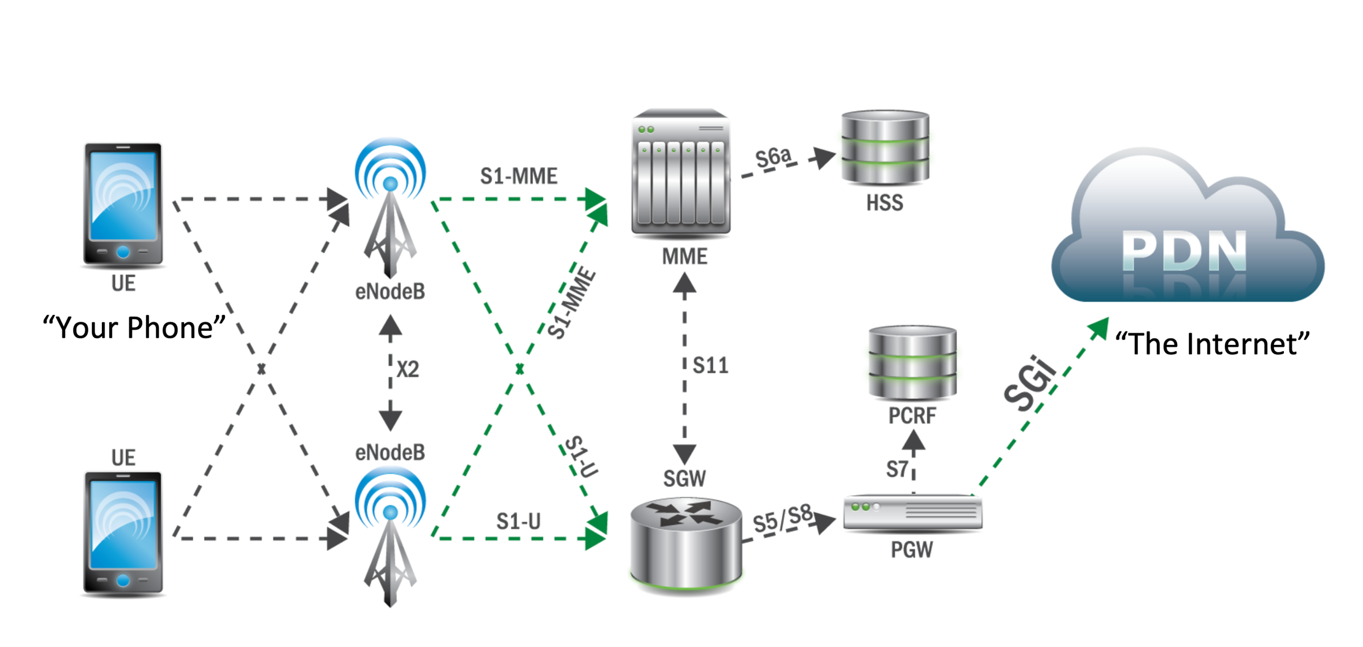
Here’s what LTE looks like

Slide 10
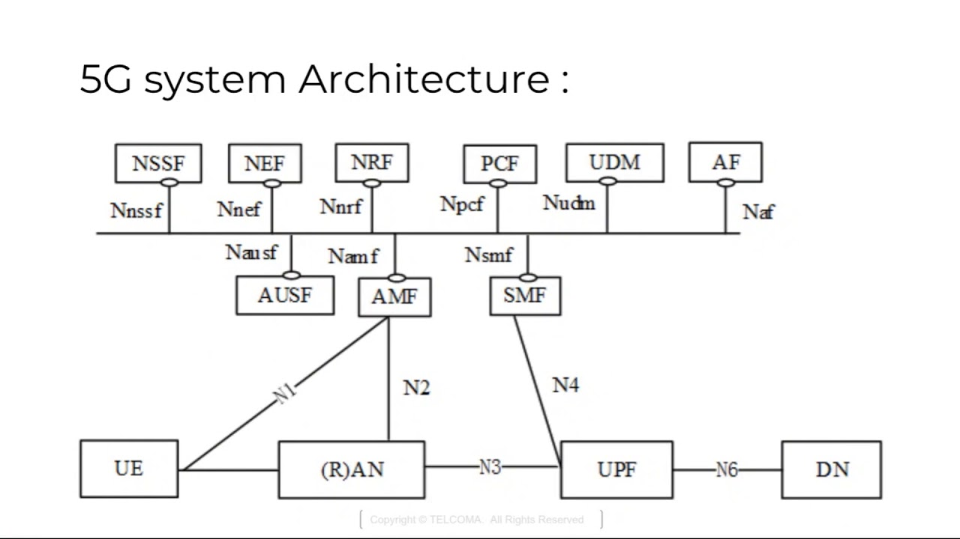
And here’s what 5G looks like
“The Internet”

Slide 11
Let’s make an analogy - LTE

Slide 12



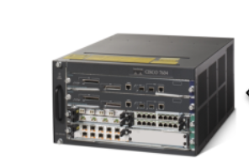
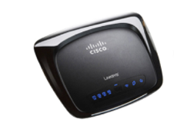
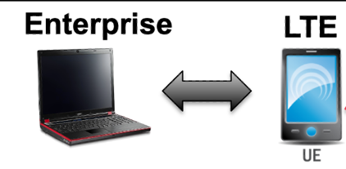
Let’s make an analogy – 5G

Slide 13
But what does all this matter?
These things all talk to each other
If you know how they talk to each other, you can talk to them as well
Most of these protocols are funky, strange, and different
Can’t find them with Shodan

Slide 14
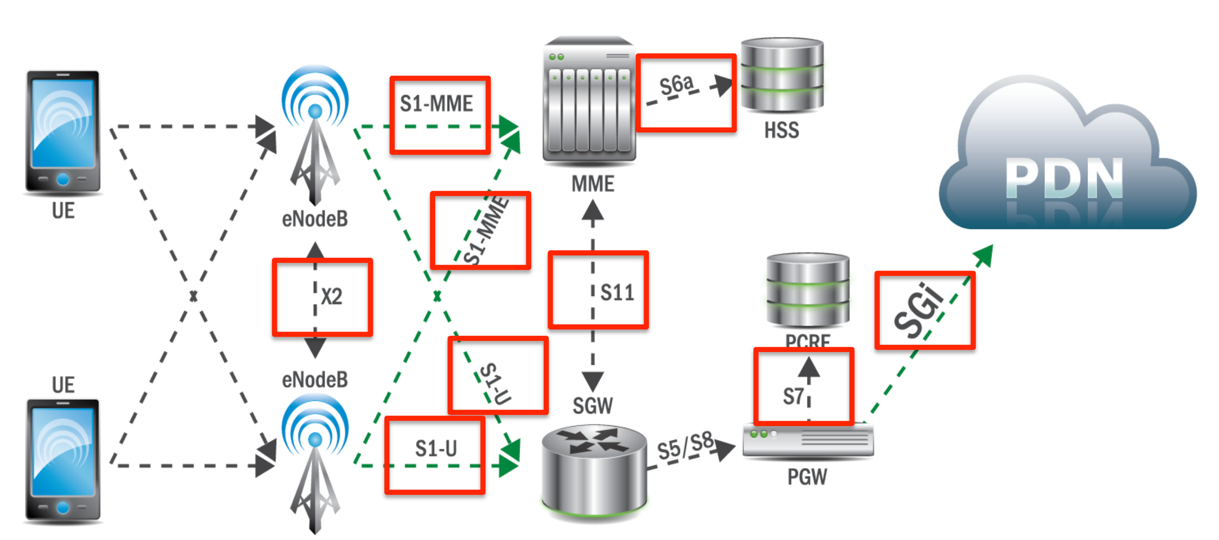
LTE Interfaces

Slide 15

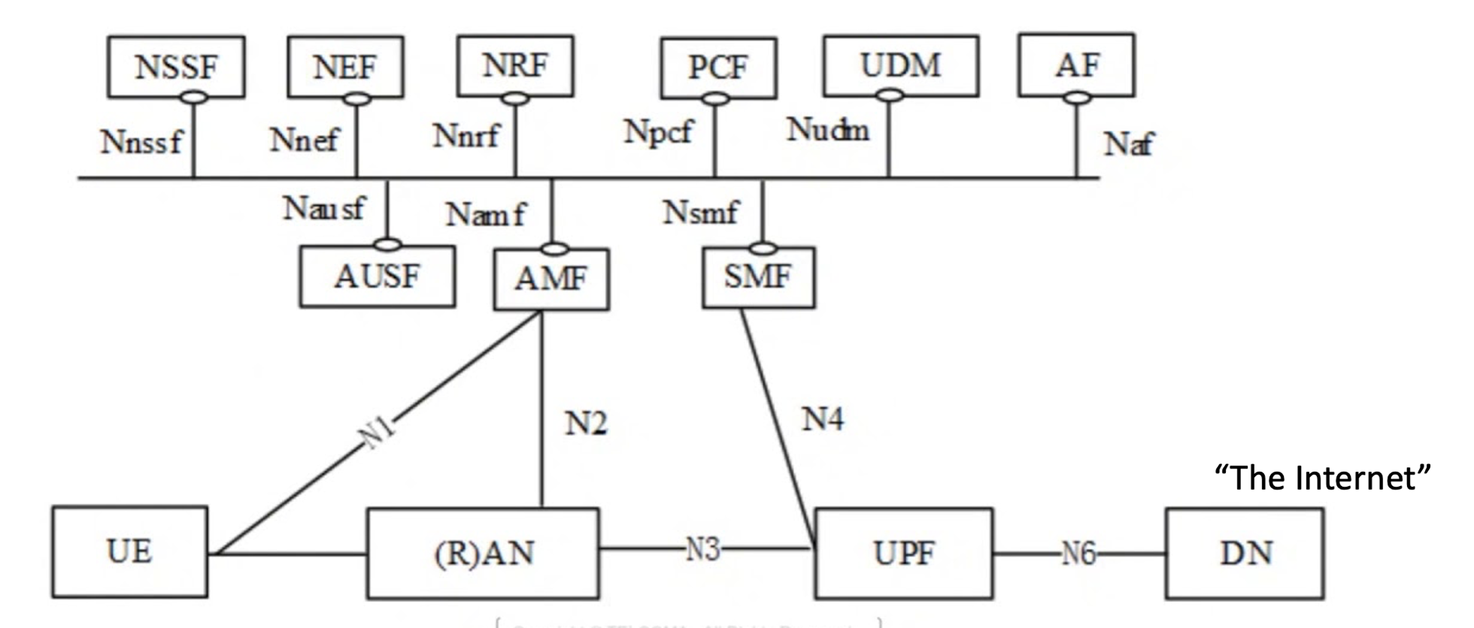
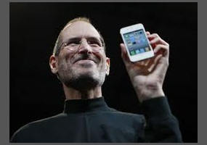
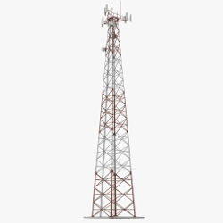
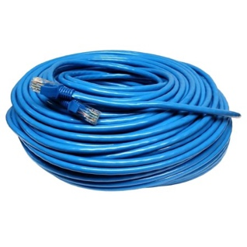

5G Attack Surface: Network “Interfaces”

Slide 16
3 critical items

Slide 17
Critical Thing 1: SCTP
Think of SCTP as a TCP replacement but more complicated
Connection oriented
4 way handshake
Session tracking
Packet loss
etc….
Sits on top of IP
Not used ubiquitously, but sometimes
Not an available protocol on Shodan
STUFF
SCTP
IP
ETH

Slide 18

Critical Thing 2: Tunnels
Looottss of tunneling protocols
Squashes MTU
Encapsulated in UDP based stuff

Slide 19
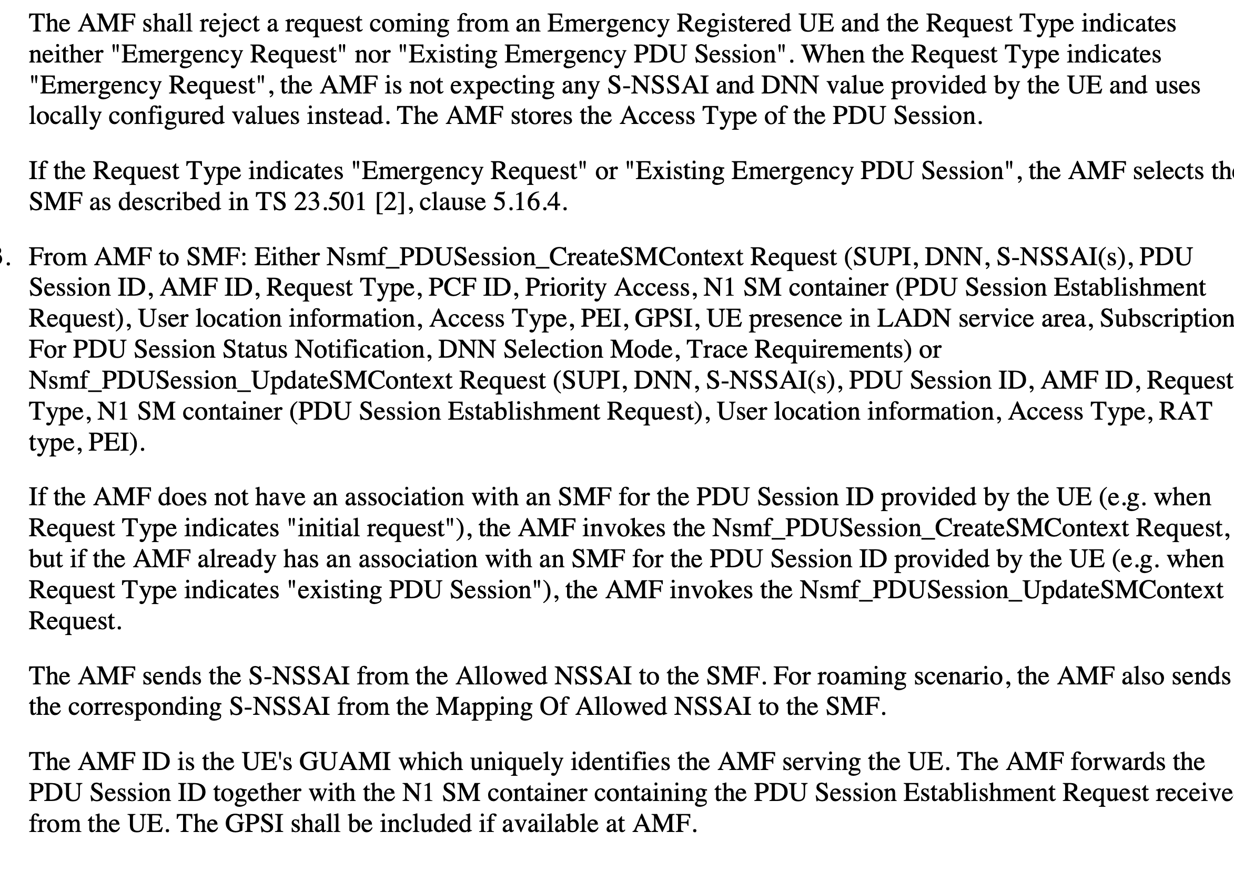
Critical Thing 3: Security through obscurity
300 page specifications
Numerous revisions that reflect nothing new
Changes in acronyms and design with each generational introduction
Don’t be dissuaded

Slide 20
How does the phone connect to the internet?
Step 3.2 (create tunnel)
Step 3.1 (create tunnel)
Step 2 (Authenticate)
Step 4 (cat pictures)
Step 1 (connect)

Slide 21
Interface N1 and N2: NGAP
These are actually one thing
NGAP <- “Next Generation Application Protocol”
SCTP Port 38412 and Payload Protocol 60
ASN.1/BER encoded information
Some data sent directly by UE, pass thru from tower
Used for AAA of phone authorizing to network
UE + RAN = Phone + Tower
AMF= Access and Mobility Management Function
NGAP
SCTP PP:60 Port: 38412
IP
ETH

Slide 22
Interface Nn**f
Kubernetes service mesh like (ideally – normally called a bus)
HTTP/2
Most modern innovation in 5G core
All of these functions in LTE were handled by a database and diameter
Designed to handle phone access and functions
connects core networking functions to cloud based stuff
AMF = Access and Mobility Management Function
SMF = Session Management Function
HTTP/2
TCP Port 443
IP
ETH

Slide 23
Interfaces N4, N3, N6
N4: PFCP – aka “IKE” for us network nerds
Precursor was called GTP-C
N3/N6: GTP-U
Like IPSec except no encryption
This is how user plane traffic finally makes it to the internet
At least PFCP and GTP-U are easily parseable protols
Both PFCP and GTP-U support a “ping” like request
N3/N6
N4
Cat Pictures (IP/TCP/HTTP)
PFCP
GTP-U
UDP Port 8805
UDP
IP
IP
ETH
ETH

Slide 24

OK, I grokked about 35%, I want to learn more

Slide 25
Finding things on the Internet
How to find an AMF or RAN (Tower)
https://github.com/nobletrout/sctpscan
Set SCTP port to 38412 (we found about 50)
LTE version: 36412 (we found around 600 or so)
How to find a UPF or SMF
UDP port 8805
Send a PFCP Heartbeat Request
Shodan will find LTE equipment doing this on UDP 2123 & 2152 but not 8805
These are called GGSN’s and SGW’s but it’s the same thing just older
Find the cloud stuff Nn**f
HTTP/2
Have not read the docs yet on that, but it’s a documented HTTP API
Note: a lot of the stuff we found was not available on Shodan (404 pirate)

Slide 26
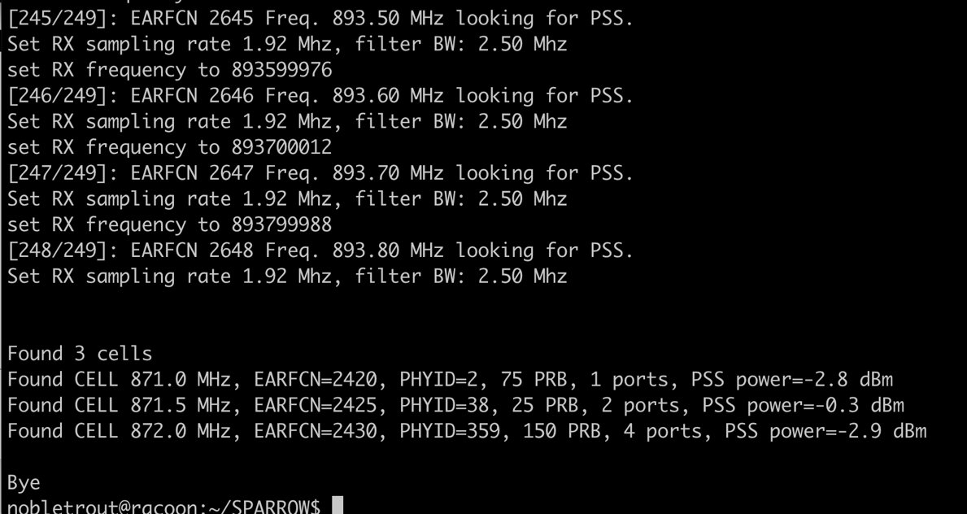
I want to find cell phone towers with radios
Get yourself srsRAN and a good SDR (US Robotics Best, BladeRF ok)
https://github.com/srsran/srsRAN
srsRAN supports a full wireless network deployment, both as a UE or RAN + EPC
After compiling, run lib/examples/cell_search -b 5
This is what Crocodile Hunter does under the hood and matches to the FCC’s list of known broadcasters

Slide 27
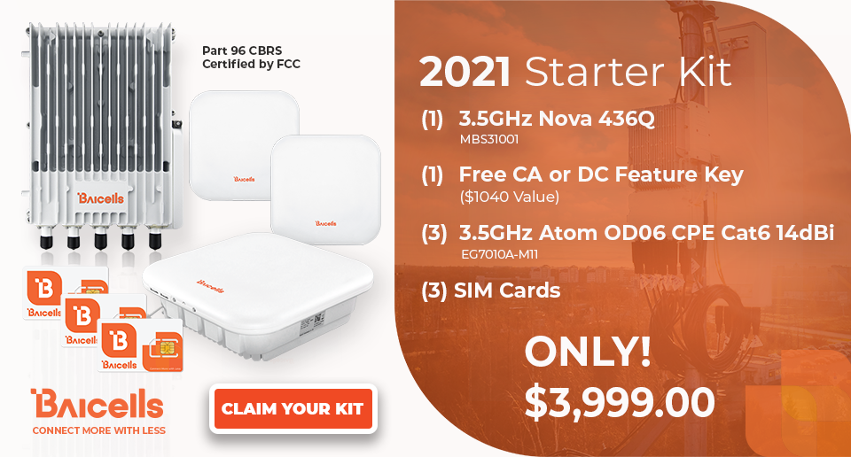
I want to build a working LTE/5G network
COTS are available
It is legal with CBRS
Can probably do it for around $1000
Vendors:
Baicell
Blinq networks
Aruba
Ruckus
Will even offload all the 5G core for you to the ”cloud”

Slide 28
Or maybe you want to work on 5G core code
Facebook sponsors a program called magma.
https://magmacore.com
BSD Licensed
Active slack community
Open5gs
https://open5gs.org/
AGPL
Many commercial implementations from the “big guys”
Nokia Siemens
Ericson
Cisco

Slide 29
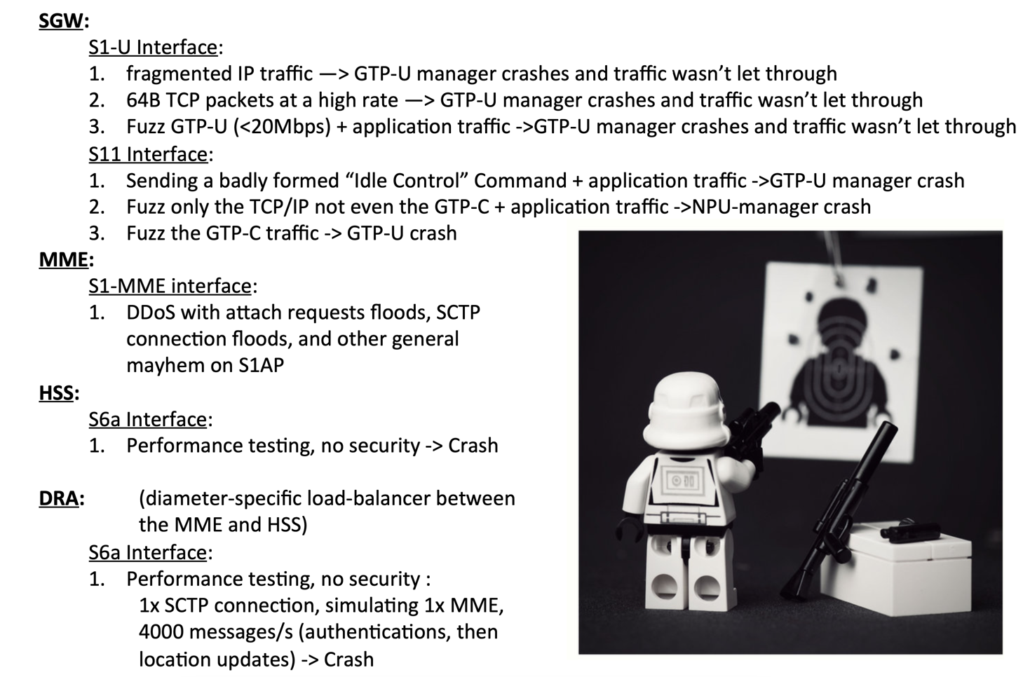
Ongoing Security Concerns
No robust fuzzers, either commercial or open source, that focus on any of these protocols
DDoS-able
Obscurity and protected knowledge breeds contempt for safety
A history of being easily broken

Slide 30
Things I want to do and questions
I want to make
protocol fuzzers
DDoS PoC’s
shodan for mobile equipment
protocol decoders and analyzers
SPARROW implementation in srsRAN (see defcon)
I have
Little time
SDR’s
nobletrout at the following places
twitter
infosecboston.slack.com
Gmail
wanna learn more?
https://www.youtube.com/watch?v=WjxK09jKYpo
Type things into google like ”N4 interface 3gpp”
https://www.developingsolutions.com/
https://www.3gpp.org/release18

